Slide 1
서브라임텍스트 대신
Visual Studio Code로
만들어 보는 웹 환경
김영욱 Technical Evangelist
부장/ DX / Microsoft
youngwook@outlook.com
Blog: Youngwook.com
“ ”
Notes:
안녕하세요 테크니컬 에반젤리스트 김영욱입니다.
평소에는 윈도우와 전쟁사 이야기를 많이 하고 있지만 최근에는 사물 인터넷 이야기를 많이 하게됩니다.

Slide 3
Visual Studio Code A deep dive on the code editor for OS X, Linux and Windows
Chris Dias - Microsoft
Erich Gamma - Microsoft
John Papa - johnpapa.net
3-680

Slide 5

editor
IDE
lightweight/fast
file/folders
many languages
many workflows
keyboard centered
project systems
code understanding
debug
integrated build
File>New, wizards
designers
ALM integration
platform tools
...
lightweight/fast
file/folders with project context
many languages
keyboard centered
code understanding (some languages)
debug
task running

Slide 6
Visual Studio Code a new choice of tool that combines the simplicity of a code editor with what developers need for their code-edit-debug cycle.

Slide 7
Visual Studio Code
* state as of preview
runtimes | node.js, ASP.Net 5
languages - basic* coloring, brackets, indent | CoffeeScript, Python, Ruby, Jade, Clojure, Java, C++, R, Go, makefile, shell, powershell, bat, XML, Markdown, ...
languages - better + IntelliSense, linting, outline | JavaScript, HTML, CSS, LESS, SASS, JSON
languages - best + find all refs, refactoring | C#, TypeScript
source control | git
task running | gulp, grunt ...

Slide 8

+ Squirrel for application updates
+ FirstMate for TextMate syntax bundle support

Slide 9
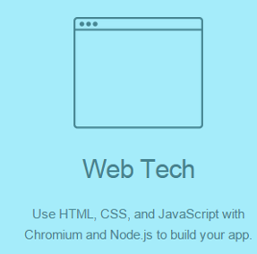
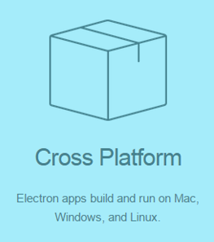

Slide 10
Monaco Editor

Slide 11
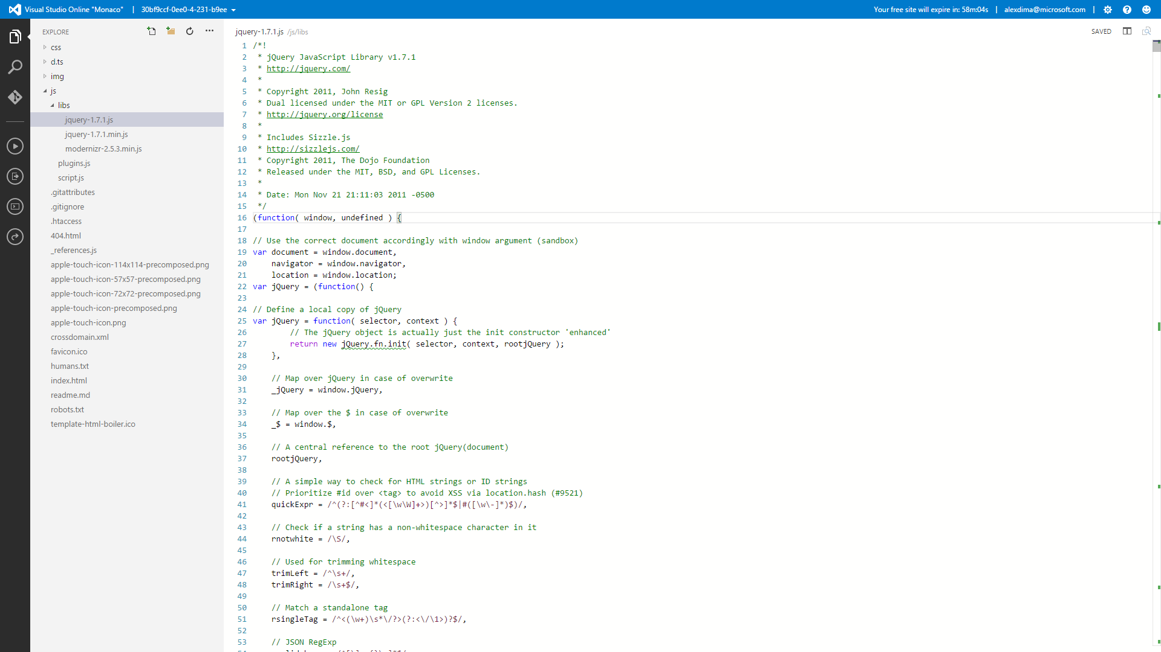


Slide 12
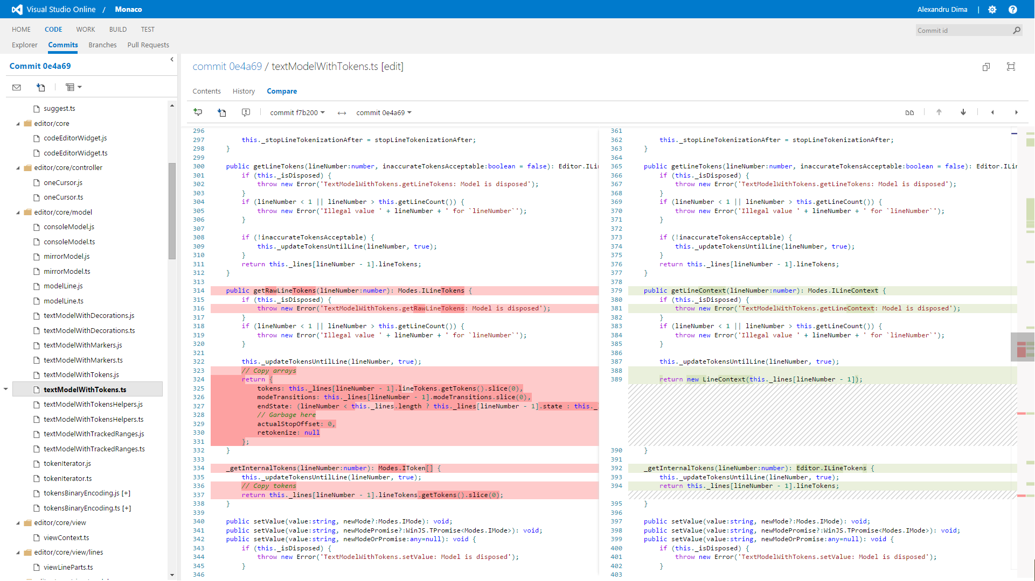


Slide 13
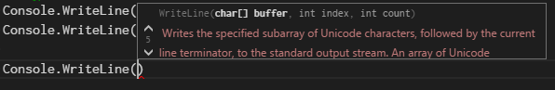
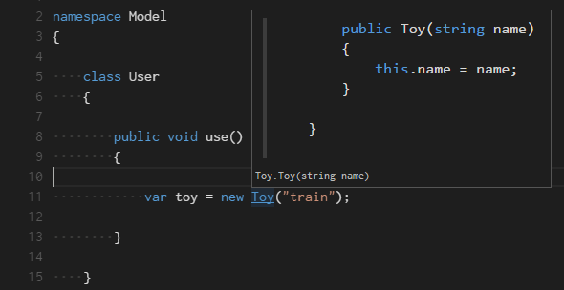
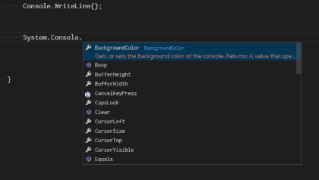
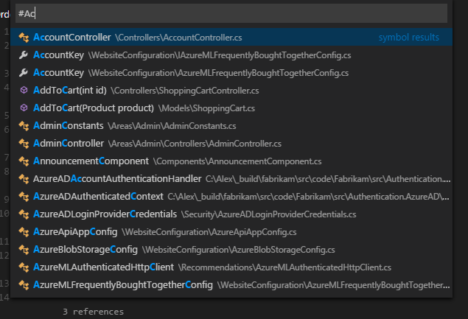
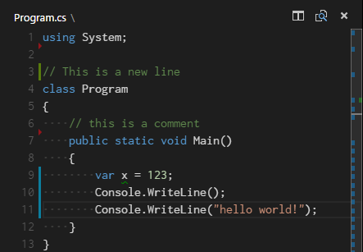
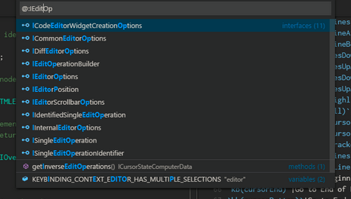
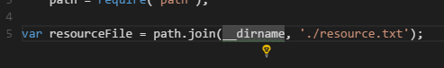
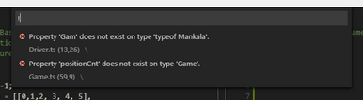
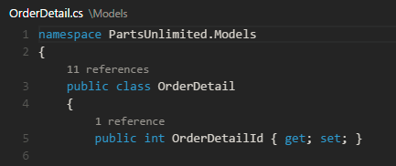
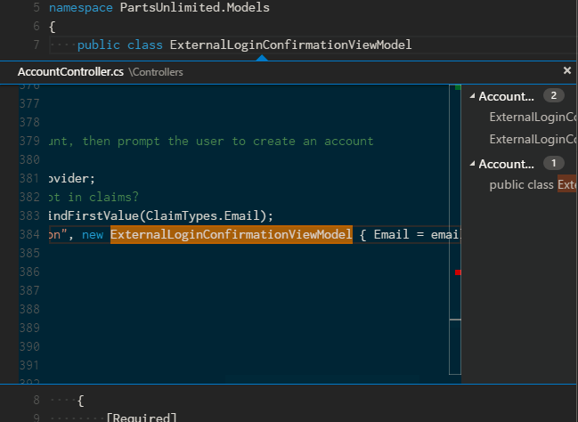
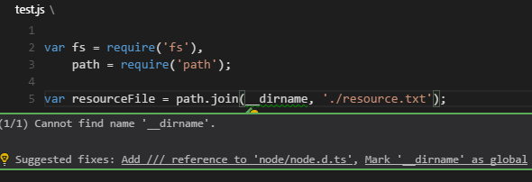
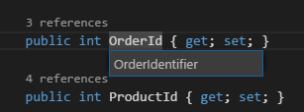
parameter hints
IntelliSense
goto definition/preview
goto any symbol
gutter
code actions
goto symbol in file
error/warnings
inline references
find all references
inline errors
rename symbol

Slide 14


TypeScript Server
OmniSharp Roslyn

Slide 15
Tools Service Architecture
OmniSharp Server
C#, ASP.NET 5
TypeScript Server
TS, Node.js
VS Code
Node Dbg Adapter
JS, Node.js
Mono Dbg Adapter
C#, mono
JSON

Slide 16
Protocols
Language Worker Service
Request | Response
definition | Returns the file location of the symbol at the given file location
references | Returns the file locations that reference the symbol at the given file location
completions | Returns possible completions at a given file location
symbolDetails | Return a type information and documentation for the symbol at a given file location
format | Returns edit instructions to format a file
outline | Returns list of navigation targets for a particular file
open | Notifies the server that the editor host has opened a file
close | Notifies the server that a previously opened file is now closed
change | Notifies the server that a range of a file has changed
Debugger Adapter Service
Request
launch | Launch a debugee
setBreakpoints | Sets multiple break points
continue, next, stepIn, stepOut | Execution control
stackTrace | Returns the stack trace from the current execution state
variables | Returns the children of all variables given a variable reference
Event
stopped | The execution of the debugee has stopped
exited | The debugee has terminated

Slide 17
Call to Action
http://code.visualstudio.com
Connect with us https://code.visualstudio.com/Home/Connect
Join the Insiders group
Send us a smile
Send us suggestions Send us bugs

Slide 18
Resources
OmniSharp http://www.omnisharp.net/
TypeScript http://www.typescriptlang.org/
Yo generator http://jpapa.me/yohottowel
Snippets http://jpapa.me/ngstyles
VS Code stuff http://johnpapa.net/visual-studio-code
TypeScript demo http://jpapa.me/vscodetsdemo

Slide 19


